Slide 1
DAY-2 GEN AI
5)Create a Login Screen
<!DOCTYPE html>
<html lang="en">
<head>
<meta charset="UTF-8">
<meta name="viewport" content="width=device-width, initial-scale=1.0">
<title>Login Screen</title>
<style>
body {
font-family: Arial, sans-serif;
background-color: #f0f0f0; margin: 0;
padding: 0; display: flex;
justify-content: center;
align-items: center; height: 100vh;
}
.login-container { background-color: #fff; border-radius: 5px; padding: 20px;
box-shadow: 0 2px 4px rgba(0, 0, 0, 0.1);
}
.login-container h2 { text-align: center;

Slide 2
margin-bottom: 20px;
}
.input-group {
margin-bottom: 15px;
}
.input-group input { width: 100%; padding: 10px; font-size: 16px;
border: 1px solid #ccc; border-radius: 5px;
}
.login-button { width: 100%; padding: 10px;
background-color: #007bff; color: #fff;
border: none;
border-radius: 5px; cursor: pointer;
}
</style>
</head>
<body>
<div class="login-container">
<h2>Login</h2>
<form>
<div class="input-group">

Slide 3
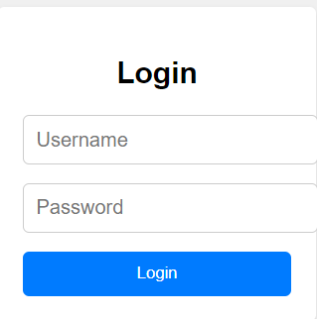
<input type="text" placeholder="Username" required>
</div>
<div class="input-group">
<input type="password" placeholder="Password" required>
</div>
<button type="submit" class="login-button">Login</button>
</form>
</div>
</body>
</html>
6)Create a User Creation Screen by using all elements in it(like List, Radio button, Drop down, CheckBox)
<!DOCTYPE html>
<html lang="en">
<head>
<meta charset="UTF-8">
<meta name="viewport" content="width=device-width, initial-scale=1.0">
<title>User Creation Screen</title>
<style>
body {
font-family: Arial, sans-serif; background-color: #f0f0f0; margin: 0;

Slide 4
padding: 0; display: flex;
justify-content: center; align-items: center; height: 100vh;
}
.user-form {
background-color: #fff;
border-radius: 5px; padding: 20px;
box-shadow: 0 2px 4px rgba(0, 0, 0, 0.1); width: 300px;
}
.form-group {
margin-bottom: 15px;
}
label {
display: block; font-weight: bold;
margin-bottom: 5px;
}
input[type="text"], select {
width: 100%;
padding: 8px; font-size: 16px;
border: 1px solid #ccc;

Slide 5
border-radius: 5px;
}
.radio-group,
.checkbox-group { display: flex;
align-items: center;
}
.radio-group input,
.checkbox-group input { margin-right: 5px;
}
button {
padding: 10px;
background-color: #007bff; color: #fff;
border: none; border-radius: 5px; cursor: pointer; width: 100%;
}
</style>
</head>
<body>
<div class="user-form">
<h2>User Creation</h2>
<form>
<div class="form-group">
<label for="username">Username:</label>

Slide 6
<input type="text" id="username" placeholder="Enter username" required>
</div>
<div class="form-group">
<label for="email">Email:</label>
<input type="text" id="email" placeholder="Enter email" required>
</div>
<div class="form-group">
<label for="gender">Gender:</label>
<div class="radio-group">
<input type="radio" id="male" name="gender" value="male">
<label for="male">Male</label>
<input type="radio" id="female" name="gender" value="female">
<label for="female">Female</label>
</div>
</div>
<div class="form-group">
<label for="country">Country:</label>
<select id="country">
<option value="usa">USA</option>
<option value="canada">Canada</option>
<option value="uk">UK</option>
</select>
</div>
<div class="form-group">
<label for="interests">Interests:</label>
<div class="checkbox-group">
<input type="checkbox" id="music" name="interests" value="music">
<label for="music">Music</label>
<input type="checkbox" id="sports" name="interests" value="sports">
<label for="sports">Sports</label>
<input type="checkbox" id="reading" name="interests" value="reading">

Slide 7
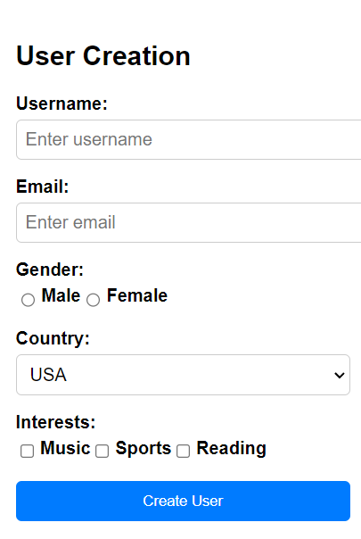
<label for="reading">Reading</label>
</div>
</div>
<button type="submit">Create User</button>
</form>
</div>
</body>
</html>
7)List all Users,Update user and Delete user(Popup for confirmation eg:Are you sure do you want to delete)
<!DOCTYPE html>

Slide 8
<html lang="en">
<head>
<meta charset="UTF-8">
<meta name="viewport" content="width=device-width, initial-scale=1.0">
<title>User List</title>
<style>
body {
font-family: Arial, sans-serif; background-color: #f0f0f0;
margin: 0;
padding: 0; display: flex;
justify-content: center;
align-items: center; height: 100vh;
}
.user-table {
background-color: #fff; border-radius: 5px; padding: 20px;
box-shadow: 0 2px 4px rgba(0, 0, 0, 0.1);
}
table {
width: 100%;
border-collapse: collapse;
}
th, td {
border: 1px solid #ccc;

Slide 9
padding: 8px; text-align: left;
}
th {
background-color: #f2f2f2;
}
</style>
</head>
<body>
<div class="user-table">
<h2>User List</h2>
<table>
<tr>
<th>Name</th>
<th>Email</th>
<th>Age</th>
<th>Country</th>
</tr>
<tr>
<td>John Doe</td>
<td>john.doe@example.com</td>
<td>30</td>
<td>USA</td>
</tr>
<tr>
<td>Jane Smith</td>
<td>jane.smith@example.com</td>
<td>25</td>
<td>Canada</td>
</tr>

Slide 10
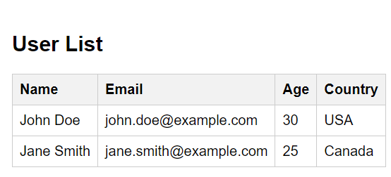
<!-- Add more rows for additional users -->
</table>
</div>
</body>
</ht ml
<!DOCTYPE html>
<html lang="en">
<head>
<meta charset="UTF-8">
<meta name="viewport" content="width=device-width, initial-scale=1.0">
<title>Update User</title>
<style>
body {
font-family: Arial, sans-serif; background-color: #f0f0f0; margin: 0;
padding: 0; display: flex;
justify-content: center;
align-items: center; height: 100vh;
}

Slide 11
.update-form { background-color: #fff; border-radius: 5px; padding: 20px;
box-shadow: 0 2px 4px rgba(0, 0, 0, 0.1); width: 300px;
}
.form-group {
margin-bottom: 15px;
}
label {
display: block; font-weight: bold;
margin-bottom: 5px;
}
input[type="text"], select {
width: 100%; padding: 8px; font-size: 16px;
border: 1px solid #ccc; border-radius: 5px;
}
button {
padding: 10px;
background-color: #007bff;

Slide 12
color: #fff; border: none;
border-radius: 5px; cursor: pointer; width: 100%;
}
</style>
</head>
<body>
<div class="update-form">
<h2>Update User</h2>
<form>
<div class="form-group">
<label for="username">Username:</label>
<input type="text" id="username" placeholder="Enter updated username" required>
</div>
<div class="form-group">
<label for="email">Email:</label>
<input type="text" id="email" placeholder="Enter updated email" required>
</div>
<div class="form-group">
<label for="age">Age:</label>
<input type="text" id="age" placeholder="Enter updated age" required>
</div>
<div class="form-group">
<label for="country">Country:</label>
<select id="country">
<option value="usa">USA</option>
<option value="canada">Canada</option>
<option value="uk">UK</option>
</select>

Slide 13
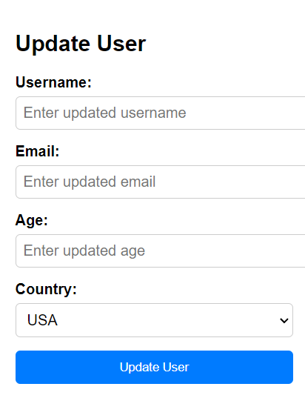
</div>
<button type="submit">Update User</button>
</form>
</div>
</body>
</html>
<!DOCTYPE html>
<html lang="en">
<head>
<meta charset="UTF-8">
<meta name="viewport" content="width=device-width, initial-scale=1.0">

Slide 14
<title>Delete User</title>
<style>
body {
font-family: Arial, sans-serif;
background-color: #f0f0f0; margin: 0;
padding: 0; display: flex;
justify-content: center;
align-items: center; height: 100vh;
}
.delete-user { background-color: #fff; border-radius: 5px; padding: 20px;
box-shadow: 0 2px 4px rgba(0, 0, 0, 0.1); width: 300px;
text-align: center;
}
button {
padding: 10px;
background-color: #dc3545; color: #fff;
border: none;
border-radius: 5px; cursor: pointer;
}
</style>

Slide 15
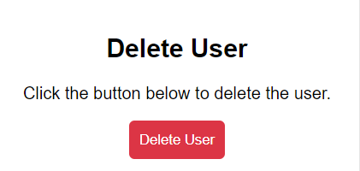
</head>
<body>
<div class="delete-user">
<h2>Delete User</h2>
<p>Click the button below to delete the user.</p>
<button onclick="confirmDelete()">Delete User</button>
<script>
function confirmDelete() {
if (confirm("Are you sure you want to delete this user?")) {
// Code to delete the user (Backend functionality would go here) alert("User deleted successfully.");
} else {
alert("Deletion canceled.");
}
}
</script>
</div>
</body>
</html>

Slide 16
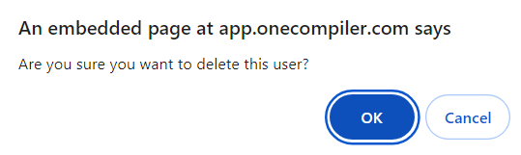
8)Create a HTML page with Google Map
<!DOCTYPE html>
<html>
<head>
<title>Google Map Example</title>
<style>
#map {
height: 400px; /* Specify the height of the map container */ width: 100%; /* Make the map fill the entire width */
}
</style>
</head>
<body>
<h1>Google Map Example</h1>
<div id="map"></div>
<script>
function initMap() {
var map = new google.maps.Map(document.getElementById('map'), {
center: {lat: 40.7128, lng: -74.0060}, // Set the initial center of the map to New York
City
zoom: 12 // Set the initial zoom level
});
}
</script>

Slide 17
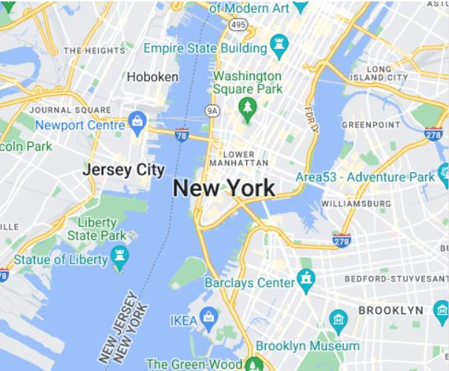
<script async defer
src="https://maps.googleapis.com/maps/api/js?key=YOUR_API_KEY&callback=initMap">
</script>
</body>
</html>
9)Create a HTML page with Video file
<!DOCTYPE html>
<html>
<head>
<title>YouTube Video Example</title>
</head>
<body>

Slide 18

<h1>YouTube Video Example</h1>
<iframe width="560" height="315" src="https://www.youtube.com/embed/_6R7Ym6Vy_I" frameborder="0" allowfullscreen></iframe>
</body>
</html>
10)Create a HTML page with Audio file
<!DOCTYPE html>
<html>
<head>
<title>Audio Example</title>
</head>
<body>

Slide 19
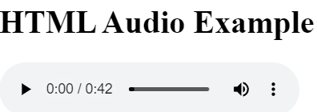
<h1>HTML Audio Example</h1>
<audio controls>
<source src="https://file- examples.com/storage/fe83e1f11c664c2259506f1/2017/11/file_example_MP3_700KB.mp3" type="audio/mp3">
Your browser does not support the audio element.
</audio>
</body>
</html>
11)Create a HTML page to upload a file
<!DOCTYPE html>
<html>
<head>
<title>File Upload Example</title>
</head>
<body>
<h1>File Upload Example</h1>
<form action="/upload" method="post" enctype="multipart/form-data">
<input type="file" name="fileToUpload" id="fileToUpload">
<br>
<input type="submit" value="Upload File">
</form>

Slide 20
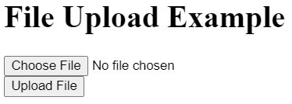
</body>
</html>
4)Difference between Authorization and Authentication
Aspect |  |  |  |  |  |  |  |  | Authentication | Authorization
 |  |  |  |  |  |  |  |  | Verifying the identity of a user or system. | Determining what resources a user or system can access.
Definition
 |  |  |  |  |  |  |  |  | Ensures that the user is who they claim to be. | Grants or denies permission to access resources.
Purpose
 |  |  |  |  |  |  |  |  | Typically involves passwords, biometrics, or tokens. | Involves setting permissions and access controls.
Process
When It Occurs |  |  |  |  |  |  |  |  | Occurs before authorization. | Occurs after authentication.
Controls |  |  |  |  |  |  |  |  | Controlled by verifying credentials. | Controlled by access policies and rules.
 |  |  |  |  |  |  |  |  | Usernames, passwords, biometric data, etc. | Access control lists, role-based access control (RBAC).
Data Involved
Scope |  |  |  |  |  |  |  |  | Identity verification only. | Access rights and privileges management.
 |  |  |  |  |  |  |  |  | Logging into an email account. | Determining which folders a logged-in user can access.
Example
 |  |  |  |  |  |  |  |  | Authorization cannot occur without authentication. | Authorization depends on the results of authentication.
Dependency
 |  |  |  |  |  |  |  |  | Usually visible to the user (e.g., login prompts). | Usually invisible to the user (e.g., access granted silently).
Visibility to User
3)Create a file with depertment as root,year as subroot and student as an element

Slide 21
<departments>
<department>
<name>Computer Science</name>
<year>
<id>1</id>
<name>First Year</name>
<students>
<student>
<id>1</id>
<name>Alice</name>
</student>
<student>
<id>2</id>
<name>Bob</name>
</student>
</students>
</year>
<year>
<id>2</id>
<name>Second Year</name>
<students>
<student>
<id>3</id>
<name>Charlie</name>
</student>
<student>
<id>4</id>
<name>Diana</name>
</student>
</students>

Slide 22
</year>
</department>
<department>
<name>Mathematics</name>
<year>
<id>1</id>
<name>First Year</name>
<students>
<student>
<id>5</id>
<name>Eve</name>
</student>
<student>
<id>6</id>
<name>Frank</name>
</student>
</students>
</year>
<year>
<id>2</id>
<name>Second Year</name>
<students>
<student>
<id>7</id>
<name>Grace</name>
</student>
<student>
<id>8</id>
<name>Hank</name>
</student>
</students>

Slide 23
</year>
</department>
</departments>
2.Create 3 XML and JSON files for department,year,student
DEPARTMENT.XML
<departments>
<department>
<id>1</id>
<name>Computer Science</name>
<head>Dr. Ramesh Kumar</head>
</department>
<department>
<id>2</id>
<name>Mathematics</name>
<head>Dr. Priya Singh</head>
</department>
<department>
<id>3</id>
<name>Physics</name>
<head>Dr. Arvind Sharma</head>
</department>
<department>
<id>4</id>
<name>Chemistry</name>
<head>Dr. Meena Patil</head>
</department>
</departments>
YEARS.XML

Slide 24
<years>
<year>
<id>1</id>
<name>First Year</name>
</year>
<year>
<id>2</id>
<name>Second Year</name>
</year>
<year>
<id>3</id>
<name>Third Year</name>
</year>
<year>
<id>4</id>
<name>Fourth Year</name>
</year>
</years>
STUDENTS.XML
<students>
<student>
<id>1</id>
<name>Alice</name>
<department>Computer Science</department>
<year>First year</year>
</student>
<student>
<id>2</id>
<name>Bob</name>

Slide 25
<department>Mathematics</department>
<year>Second year</year>
</student>
<student>
<id>3</id>
<name>Charlie</name>
<department>Physics</department>
<year>Third year</year>
</student>
<student>
<id>4</id>
<name>Diana</name>
<department>Chemistry</department>
<year>Fourth year</year>
</student>
</students>
DEPARTMENT.JSON
[
{
"id": 1,
"name": "Computer Science"
},
{
"id": 2,
"name": "Mathematics"
},
{
"id": 3,
"name": "Physics"
},

Slide 26
{
"id": 4,
"name": "Chemistry"
}
]
YEARS.JSON
[
{
"id": 1,
"name": "First year"
},
{
"id": 2,
"name": "Second year"
},
{
"id": 3,
"name": "Third year"
},
{
"id": 4,
"name": "Fourth year"
}
]
STUDENTS.JSON
[
{
"id": 1,

Slide 27
"name": "Alice",
"department": "Computer Science", "year": "First year"
},
{
"id": 2,
"name": "Bob",
"department": "Mathematics", "year": "Second year"
},
{
"id": 3,
"name": "Charlie", "department": "Physics",
"year": "Third year"
},
{
"id": 4,
"name": "Diana", "department": "Chemistry", "year": "Fourth year"
}
]
1)Difference between JSON and XML
Feature | JSON | XML | Explanation

Slide 28
Feature |  |  |  |  |  |  |  |  |  | JSON | XML |  |  | Explanation
 |  |  |  |  |  |  |  |  |  | Key-value pairs, {}, [] | Nested tags, |  |  | JSON uses a simple and straightforward syntax resembling JavaScript objects, while XML uses a more complex, tag-based structure similar to HTML.
Syntax |  |  |  |  |  |  |  |  |  |  |  | <tag></tag>
 |  |  |  |  |  |  |  |  |  | Objects and arrays |  | Elements with attributes |  | JSON's structure is based on objects and arrays, making it easier for representing data hierarchically. XML uses elements with attributes for the same purpose but with more verbosity.
Data Structure
 |  |  |  |  |  |  |  |  |  | More readable, concise |  | Less readable, verbose |  | JSON's syntax is cleaner and less verbose, making it easier to read and write. XML can become cluttered with extensive markup.
Readability
 |  |  |  |  |  |  |  |  |  | Strings, numbers, booleans, arrays, objects, null |  | Primarily text, types handled manually |  | JSON natively supports a variety of data types, while XML treats data as text, requiring additional effort to handle different types.
Type Support
 |  |  |  |  |  |  |  |  |  | JSON Schema (optional) |  | XML Schema (XSD) |  | JSON can optionally use JSON Schema for validation, whereas XML uses XML Schema Definition (XSD) for defining structure and validation.
Schema Definition
 |  |  |  |  |  |  |  |  |  | Common in web development with JavaScript |  | Widely used, including web services |  | JSON is popular in web development, especially with JavaScript-based applications. XML has a broader range of applications including web services and document storage.
Usage in Web
 |  |  |  |  |  |  |  |  |  | Lightweight, faster |  | Heavier, slower |  | JSON is generally lighter and faster to parse and transmit compared to XML, which can be more bulky and slower due to its extensive markup.
Data Interchange
 |  |  |  |  |  |  |  |  |  | Not supported |  | Supported |  | XML supports namespaces, allowing for elements from different vocabularies to be mixed without conflict. JSON does not have this feature.
Namespaces
 |  |  |  |  |  |  |  |  |  | Not supported |  | Supported (<!-- |  | JSON does not support comments, whereas XML allows for comments within the data.
Comments |  |  |  |  |  |  |  |  |  |  |  | comment --> | )
 |  |  |  |  |  |  |  |  |  | Easier and faster |  | More processing required |  | JSON is easier and quicker to parse due to its simpler structure. XML requires more processing, making it slower.
Parsing
 |  |  |  |  |  |  |  |  |  | Limited |  | Highly extensible |  | XML is highly extensible, allowing for complex document structures. JSON's extensibility is limited to its key-value pair structure.
Extensibility
 |  |  |  |  |  |  |  |  |  | Text-based, resembles JavaScript objects |  | Text-based, uses tags like HTML |  | Both are text-based formats, but JSON's format is more compact and resembles JavaScript objects, while XML uses HTML-like tags.
Format

